Slide 1


Natural Gas Engineering Project Presentation
By: Chaitanya Sangani

Slide 2
Problem Statements
1
Study the Variation in GOR and API of the vapors with pressure

Slide 3
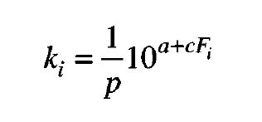
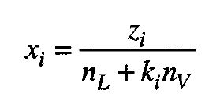
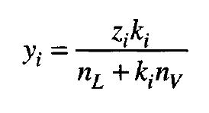
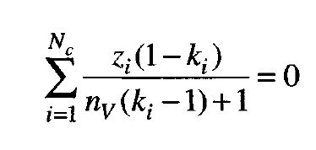
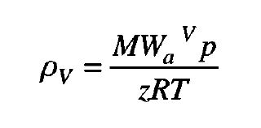
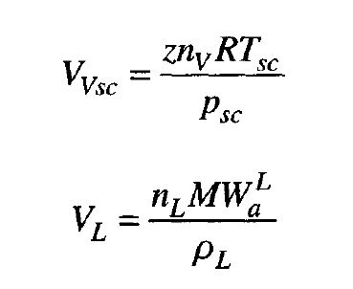
Problem Statement
Flash Distillation: Governing Equations
1. Theory
2. Simulation
3. Results
4. Analysis

Slide 4
Problem Statement 3
Simulation
1. Theory
2. Simulation
3. Results
4. Analysis
The empirical formulas and data are given as input
The function sum was used for summation function and then fzero was applied on it.

Slide 5
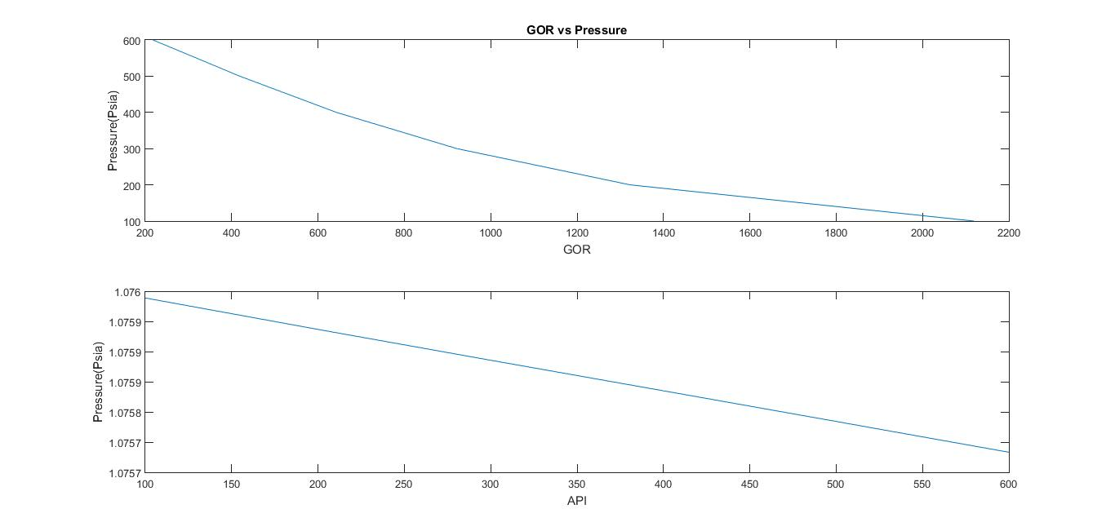
Problem Statement 2
Simulation
1. Theory
2. Simulation
3. Results
4. Analysis

Slide 6
Problem Statement 3
Results
2. Breakthrough time
3. Degradation
4. Exposure rate
2. Simulation
3. Results
1. Theory
3. Results
4. Analysis
Gas to Oil ratio decreased with increase in pressure
API of the vapours decreased with increase in Pressure

Slide 7
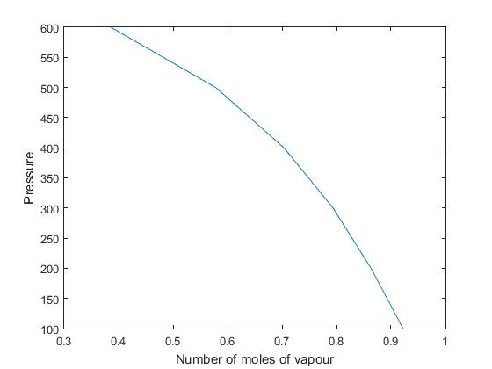
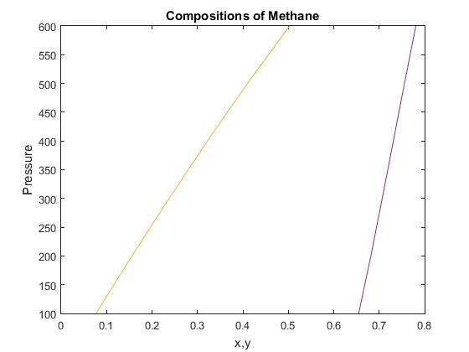
Problem Statement 3
Results
2. Breakthrough time
3. Degradation
4. Exposure rate
2. Simulation
3. Results
1. Theory
3. Results
4. Analysis

Slide 8


